Slide 1
Software Engineering II Data-driven Software Engineering
Lecturer: Shaowei Wang
Email: shaowei@cs.umanitoba.ca

Slide 2



Big data of software engineering
Large amount of artifacts are generated in the software development process
Increased amount of data available in software archives through large open source projects

Slide 3
Data-driven software engineering
What types of software data are available?
Which software engineering tasks can be assisted?
Which data mining techniques can be used?

Slide 4
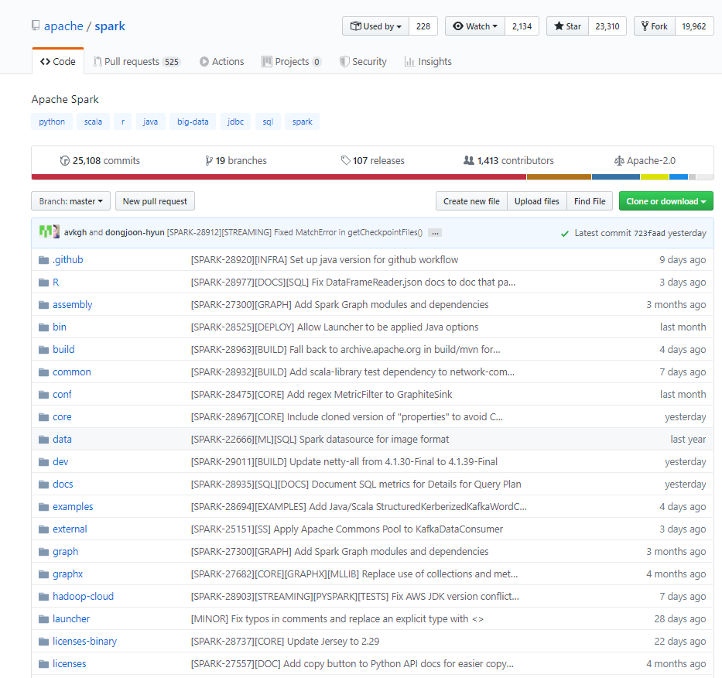
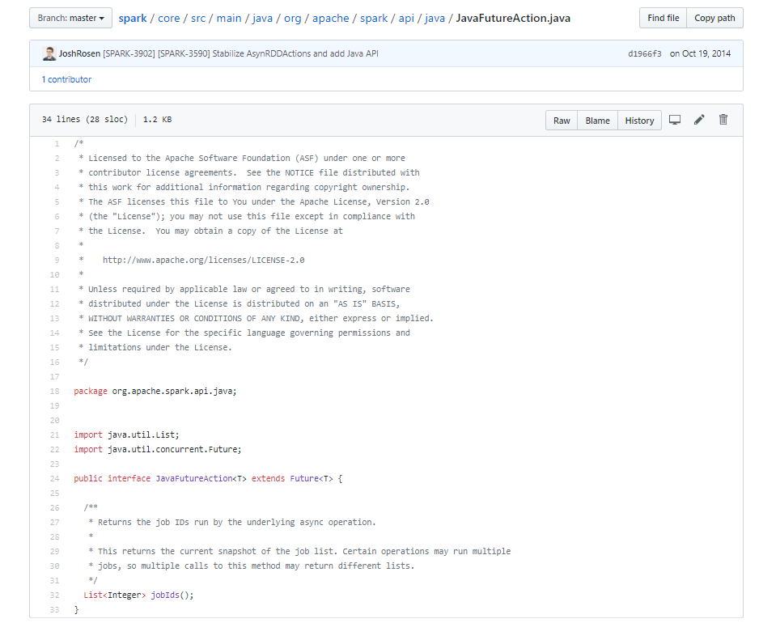
Artifact: Source Code

Slide 5
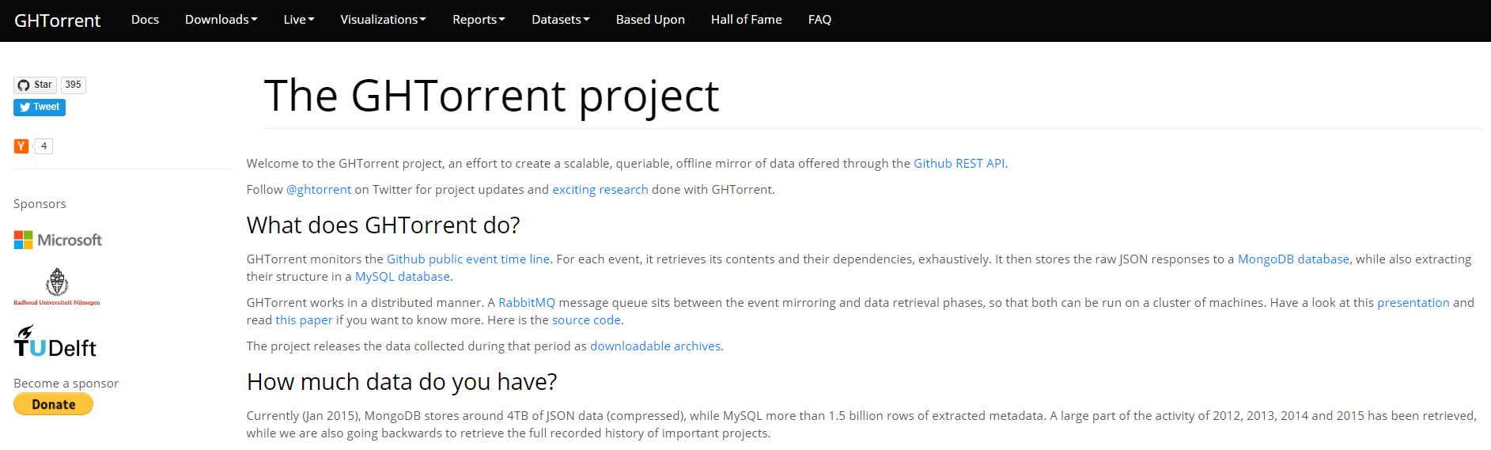
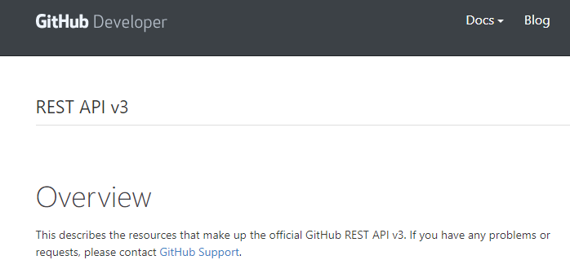
Artifact: Source Code
Where to find code?
GitHub
How to analyze source code?
Analyze -> automatically parse and understand, model using program analysis tools

Slide 6
Artifact: Source Code
Variety in code
Various programming languages Various scale: small, medium, large
Various complexities
Various systems (for web, mobile, etc.)
Various programming styles

Slide 7
What can we do with source code?

Slide 8
Applications
Leveraging source code
Code recommendation
Clone detection
Code completion
…

Slide 9
CodeHow: Improving code searching by leveraging API documentation
API recommendation + Source code search
CodeHow: Effective Code Search Based on API Understanding and Extended Boolean Model, Wang, et al, ASE 2015

Slide 10
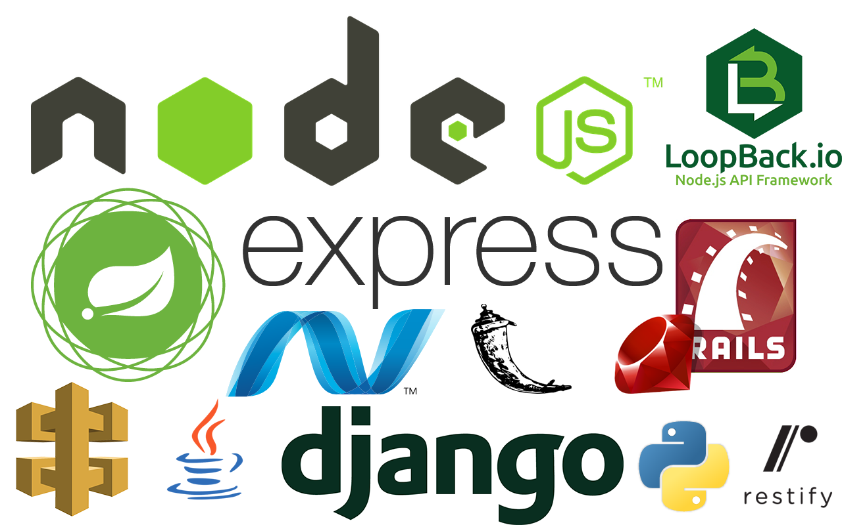







Developers leverage an enormous number of APIs when building systems
Notes:
Today, A huge number of APIs are developed and available and developers leverage them when building systems. For example, tensorflow, which is a machine learning framework open sourced by google, it provides rich number of apia to build machine learning applications.
However, a very big question is which api to use and how to use the API.

Slide 11
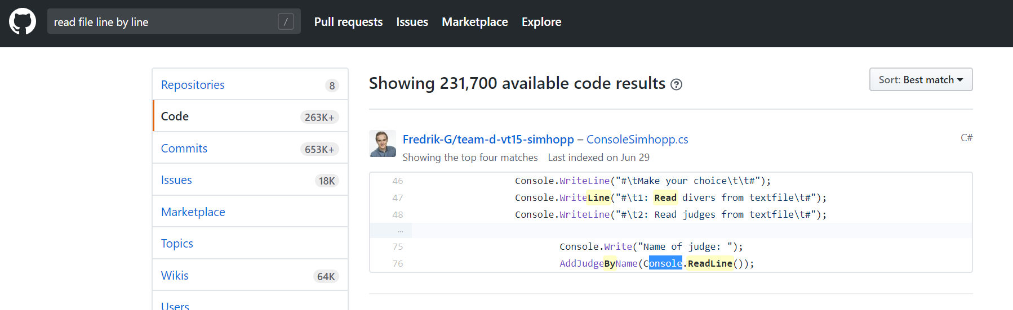

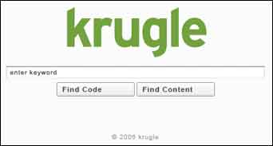

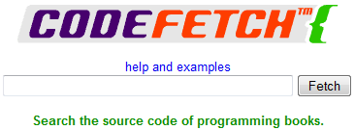
Current code search engines mostly treat code as text (text-oriented)
Read file line by line
Ohloh code
Notes:
However, current code search engines mostly treat code as text , which we called text-oriented, they don not support API search. Which leads to unsatisfied results.

Slide 12
Current code search engines mostly treat code as text (text-oriented)
Ohloh code
Notes:
However, current code search engines mostly treat code as text , which we called text-oriented, they don not support API search. Which leads to unsatisfied results.

Slide 13



Query:
read file line by line
Text-oriented Code
search engine
code snippets
Identify
relevant APIs
Collection of APIs with their online docs
World’s Code
Notes:
Now, we have candidate code snippets for users, but since there exists usually irrelevant code in the candidates results. In order to return them more compact results, we remove the irrelevant code by slicing.

Slide 14
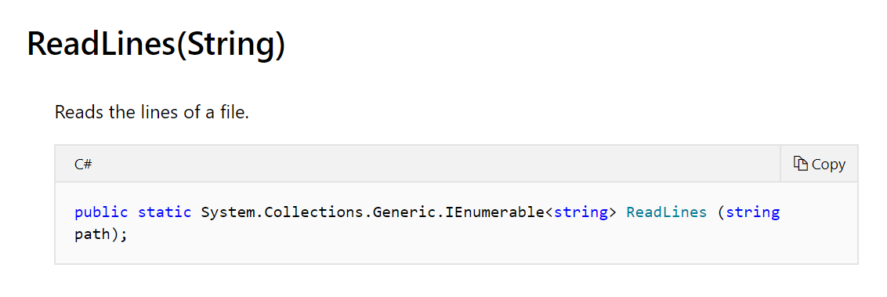
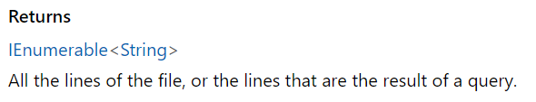
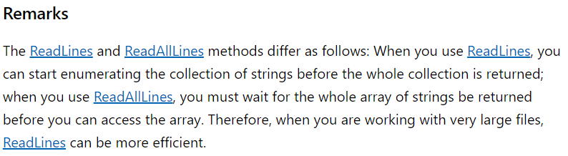
Identify relevant APIs to a Query using online API documentation
Notes:
The reason why we leverage the online documentation is that such documentation usually provide richer description about the functionality of the api than the api name itself.

Slide 15

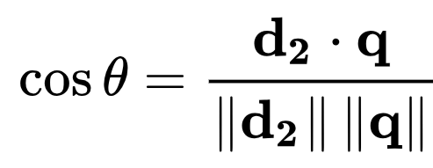
Use a Vector Space Model to measure the similarity between a Query and the API docs
Query: read file line by line
q
TF-IDF
[ read, file, line, by ]
[ 0.27, 0.2, 0.2, 0.1]
Vector space mode (VSM)
API name | text
System.IO.File.Readlines | Read the lines of a file. The Readlines and ReadAllLines …
… | …
d2
TF-IDF
[ read, file, line, all, … ]
[ 0.3, 0.1, 0.3, 0.2 , … ]
Notes:
How we calculate the similarity? I used vector space model here. Vsm converts each doc to a vector, the each element of a vector is tf-idf value for each word.
tf-idf is term frequency inverse document frequency.
Basically if a word appears more frequently in a doc, and less frequently in the corpus, this word is more important for the document, and higher tf-idf value it has.
Then, we use cosine similarity to compute the similarity of two vectors. Higher value indicates the enriched text is more relevant to the query.
We select top apis as the relevant ones and use them to extend our original query.

Slide 16
Query:
read file line by line
Text-oriented Code
search engine
code snippets
Identify
relevant APIs
Collection of APIs with their online docs
World’s Code
API-oriented code
search engine
Extended Query:
original query + relevant APIs (e.g., File.Readlines())
Notes:
Now, we have candidate code snippets for users, but since there exists usually irrelevant code in the candidates results. In order to return them more compact results, we remove the irrelevant code by slicing.

Slide 17
Code retrieval in API-oriented code search engine
Extended query (EQ)
Code snippet (C)(Method level)
Relevant APIs
Original query
APIs in method
Method name
Method body
void readFileLines(String file){
Var lines = File.ReadLines(file);
Foreach(var line in lines){
Console.print(line);
}
}
Notes:
Different from the text-oriented search engine, in api-oriented code search engine, we treat code differently. We extract the APIs which are called in the code snippet and regard it individually, separate from other source code. We treat method name and method body differently.

Slide 18
Code retrieval in API-oriented code search engine
Extended query (EQ)
Code snippet (C)(Method level)
Relevant APIs
Original query
APIs in method
Method name
Method body
Similarity (EQ, C) =
Extended Boolean Model
Extended Boolean Model
Notes:
After getting the extended query, we calculate the similarity of query and each code snippets as follows:
We calculate the similarity between relevant apis in extended query with apis in the method, using extended Boolean model,
We also compute the similarity between original query and method name and method body.
At last, we sum up these two parts of scores as the final score.
We didn’t merge all fileds of information together and compute similarity in one shot since we don’t want to the information in each field be disturbed by each others. And also make easy for us to tune the weights from each field.

Slide 19

Query:
read file line by line
Text-oriented Code
search engine
code snippets
Identify
relevant APIs
Collection of APIs with their online docs
World’s Code
API-oriented code
search engine
Extended Query:
original query () + relevant APIs (e.g., File.Readlines())
code snippets
Notes:
Now, we have candidate code snippets for users, but since there exists usually irrelevant code in the candidates results. In order to return them more compact results, we remove the irrelevant code by slicing.

Slide 20
Remove irrelevant code using slicing
int i;
int sum = 0;
int product = 1;
int w = 7;
String path = “/home/”;
for(i = 1; i < N; ++i) {
sum = sum + i + w; product = product * i;
}
File f = new File(path)
f.writeline(sum);
print(product);
Notes:
Since we search in a method level, there are have some irrelevant code in the retrieved code snippets. So we want to return more compact code snippets to users.
Suppose f.writeline is the relevant API, we collected from API understanding step. The code related to product is not relevant to api f.write, so we remove such irrelevant code to make sure the returned code is compact but also have enough context information to show user how to use an API.

Slide 21
Remove irrelevant code using slicing
int i;
int sum = 0;
int product = 1;
int w = 7;
String path = “/home/”;
for(i = 1; i < N; ++i) {
sum = sum + i + w; product = product * i;
}
File f = new File(path)
f.writeline(sum);
print(product);
int i;
int sum = 0;
int w = 7;
String path = “/home/”;
for(i = 1; i < N; ++i) {
sum = sum + i + w;
}
File f = new File(path)
f.writeline(sum);
Notes:
We slice the statements that do not have dependency with the api, we only keep the necessary context for the api.

Slide 22
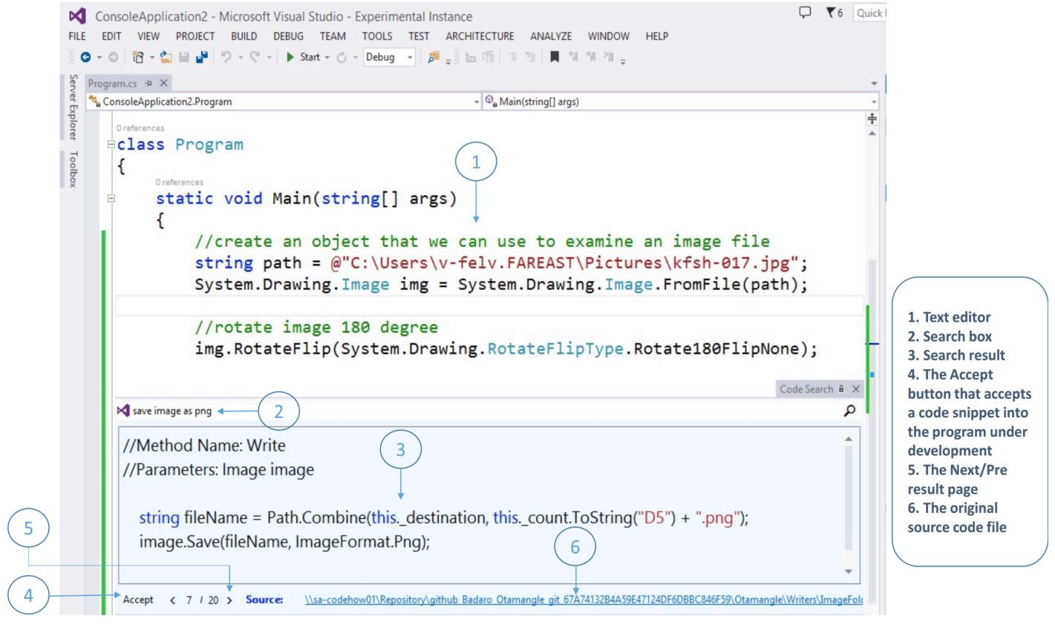
Save image as png

Slide 23
Vectorization and similarity calculation
Query: read file line by line
q
TF-IDF
[ read, file, line, by ]
[ 0.27, 0.2, 0.2, 0.1]
Vector space mode (VSM)
API name | text
System.IO.File.Readlines | Read the lines of a file. The Readlines and ReadAllLines …
… | …
d2
TF-IDF
[ read, file, line, all, … ]
[ 0.3, 0.1, 0.3, 0.2 , … ]
Notes:
How we calculate the similarity? I used vector space model here. Vsm converts each doc to a vector, the each element of a vector is tf-idf value for each word.
tf-idf is term frequency inverse document frequency.
Basically if a word appears more frequently in a doc, and less frequently in the corpus, this word is more important for the document, and higher tf-idf value it has.
Then, we use cosine similarity to compute the similarity of two vectors. Higher value indicates the enriched text is more relevant to the query.
We select top apis as the relevant ones and use them to extend our original query.

Slide 24
Text Preprocessing
Tokenization
Stop-word Removal
Stemming

Slide 25
Text: Tokenization
Breaking a document into its constituent tokens or terms
In a textual document, a token is typically a word.
Steps:
Segmenting text into words. Most existing tokenizers signal token boundaries by white spaces.
Handling Abbreviations
E.g., Str is abbreviation of String.
3. Handling Hyphenated Words
E.g., visual-studio
4. Numerical and special expressions
E.g., I installed an eclipse 4.3
Depends on the data and queries
Note: if you consider social media, you might need more text normalization techniques.

Slide 26
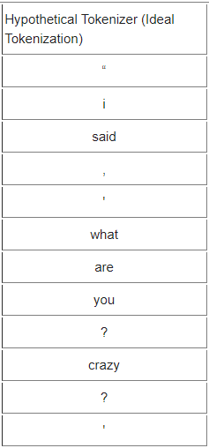
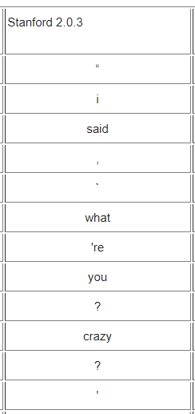
Tokenization Example
"I said, 'what're you? Crazy?’

Slide 27
Text: Stop-Word Removal
Top 1% word?
stop words = extremely common words which would appear to be of little value in helping select documents matching a user need
Examples: a, an, and, are, as, at, be, by, for, from, has, he, in, is, it, its, of, on, that, the, to, was, were, will, with
Stop word elimination used to be standard in older IR systems.
But you need stop words for phrase queries, e.g. “King of Denmark”
Most web search engines index stop words.
Note: better try both, with stop-word, after removal, any improvement?

Slide 28
Text: Stemming
Definition of stemming: Crude heuristic process that chops off the ends of words to reduce related words to their root form
E.g., automate, automatic, automation all reduce to automat
Porter’s Algorithm
Most common algorithm for stemming English
Results suggest that it is at least as good as other stemming options
Used to reduce the variation of words and vobaculary

Slide 29
Should I use stemming?
Depends: stemming can increase effectiveness for some queries and decreases effectiveness for others.
Queries where stemming is likely to help:
[tartan sweaters], [sightseeing tour san francisco]
(equivalence classes: {sweater,sweaters}, {tour,tours})
Increase recall
Queries where stemming hurts:
[operational research], [operating system], [operative dentistry]
Lose information
Notes:
Other stemming algorithms:
Lovins stemmer
Paice stemmer
Etc.

Slide 30
Code Preprocessing
Regard as NLP
Leveraging static analysis
Parsing
Identifier Extraction
Identifier Split
Identifier Expansion
void readFileLines(String file){
Var lines = File.ReadLines(file);
Foreach(var line in lines){
Console.print(line);
}
}

Slide 31
Code: Parsing
Creating an abstract syntax tree (AST) of the code.
Identify which ones are variable names, which ones are method calls, etc.
Difficulties:
Multiple languages
Partial code (imcomplete code snippets)
Tools:
ANTLR
Java parser

Slide 32







Code: Identifier Extraction
Extract the names of identifiers in the code.
Method names
Variable names
Parameter names
Class names
Extract the comments in the code
`

Slide 33
Code: Identifier Split
Break identifier names into tokens.
printLine => print line
System.out.println => system out println
Many identifier names are in camel casing (printLine) or underscore (print_line).
When no Camel Case convention or other separator is used, e.g., fixbug, we need rules/patterns to auto split identifier.
Why do we need to break identifier names?
Reduce vocabulary and increase recall
Do all identifiers need to be broken?
No always
Notes:
If you search task is within a very special system and focus on high precision. no

Slide 34
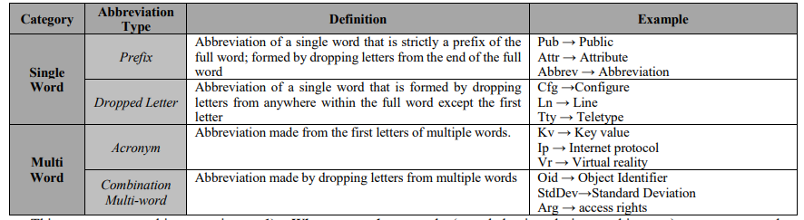
Code: Identifier Expansion
Mapping soft-words to their corresponding domain concepts.
It is helpful for programming languages (e.g., C and C++) that favor the use of short identifiers.
Ref.An Empirical Study of Abbreviations and Expansions in Software Artifacts
Notes:
In such languages, the use of abbreviations and acronyms is likely an heritage of the past when certain operating systems and compilers limited the maximum length of identifiers. In fact, a C developer may use the soft-word dir instead of the hard-word directory, pntr instead of pointer, or net instead of network

Slide 35
representation
Document Representation
Bag-of-Word Model
Term Frequency (TF)
Word2vec
BERT

Slide 36
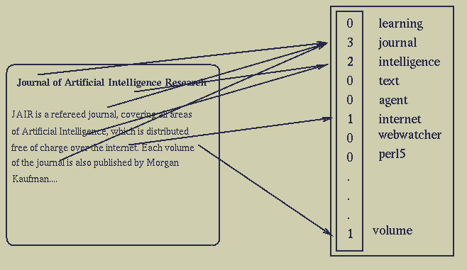

Bag-of-words document representation

Slide 37

Word weighting
In the bag-of-words representation each word is represented as a separate variable having numeric weight (importance)
The most popular weighting schema is normalized word frequency TFIDF:
Tf(w) – term frequency (number of word occurrences in a document)
Df(w) – document frequency (number of documents containing the word)
N – number of all documents
TfIdf(w) – relative importance of the word in the document
The word is more important if it appears
several times in a target document
The word is more important if it appears in less documents
Notes:
To do this we make use of inverse document frequency (IDF):
N is the total number of documents in the corpus
df_{t} is the document frequency of t: the number of documents that contain t

Slide 38
Bag of Words Consideration
We consider a document as a multi-set of its constituent words (or terms).
We do not consider the order of words in a document.
John is quicker than Mary, and
Mary is quicker than John
are represented the same way.

Slide 39
How to “transfer” or “share” knowledge between words?
Vector Embedding: Word Similarity
Word embeddings depend on a notion of word similarity.
A very useful definition is paradigmatic similarity:
Similar words occur in similar contexts. They are exchangable.
e.g., we can remove/discard the word from the string.
This definition supports unsupervised learning: cluster or embed words according to their contexts.
Idea: representing a word by means of its neighbors

Slide 40
Word2vec: Local contexts
Embedding: word2vec
Word2vec uses words a few positions away from each center word.
“It was a bright cold day in April, and the clocks were striking”
Center word: red
Context words: blue

Slide 41
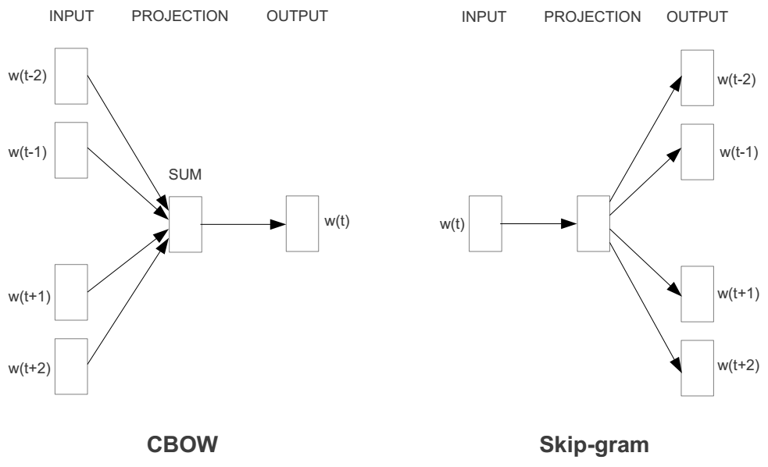
word2vec
2 basic neural network models:
Continuous Bag of Word (CBOW): use a window of word to predict the middle word
Skip-gram: use a word to predict the surrounding ones in window.
Faster, good for frequent words
Represents well even rare words
Notes:
Skip-gram: works well with small amount of the training data, represents well even rare words or phrases.
CBOW: several times faster to train than the skip-gram, slightly better accuracy for the frequent words
The order of context words does not influence prediction (bag-of-words assumption). In the continuous skip-gram architecture, the model uses the current word to predict the surrounding window of context words. The skip-gram architecture weighs nearby context words more heavily than more distant context words.^{[1][6]} According to the authors' note,^{[7]} CBOW is faster while skip-gram does a better job for infrequent words.

Slide 42
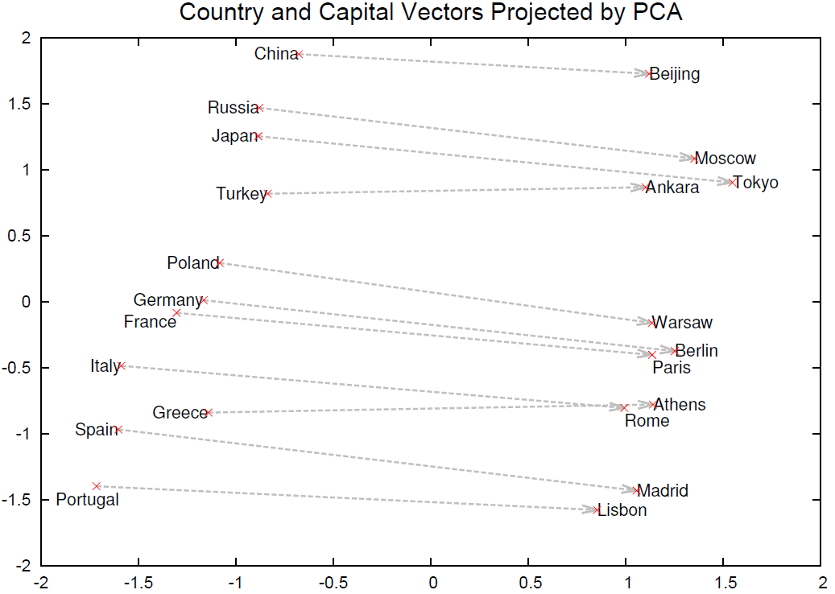

Word2vec: Local contexts
Local contexts capture much more information about relations and properties :

Slide 43
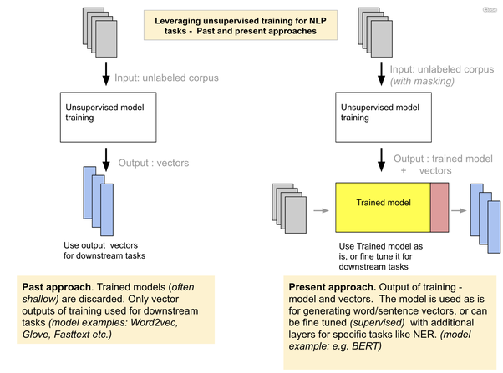
BERT: Pre-training of Deep Bidirectional Transformers for Language Understanding
BERT can generate different word embeddings for a word that captures the context of a word
https://github.com/hanxiao/bert-as-service

Slide 44
CodeBERT
CodeBERT learns general-purpose representations that support downstream NL-PL applications such as natural language code search, code documentation generation
It is trained with Transformer-based neural architecture
Use comment-code pair for training
CodeBERT: A Pre-Trained Model for Programming and Natural Languages, Feng et al. EMNLP 2020

Slide 45
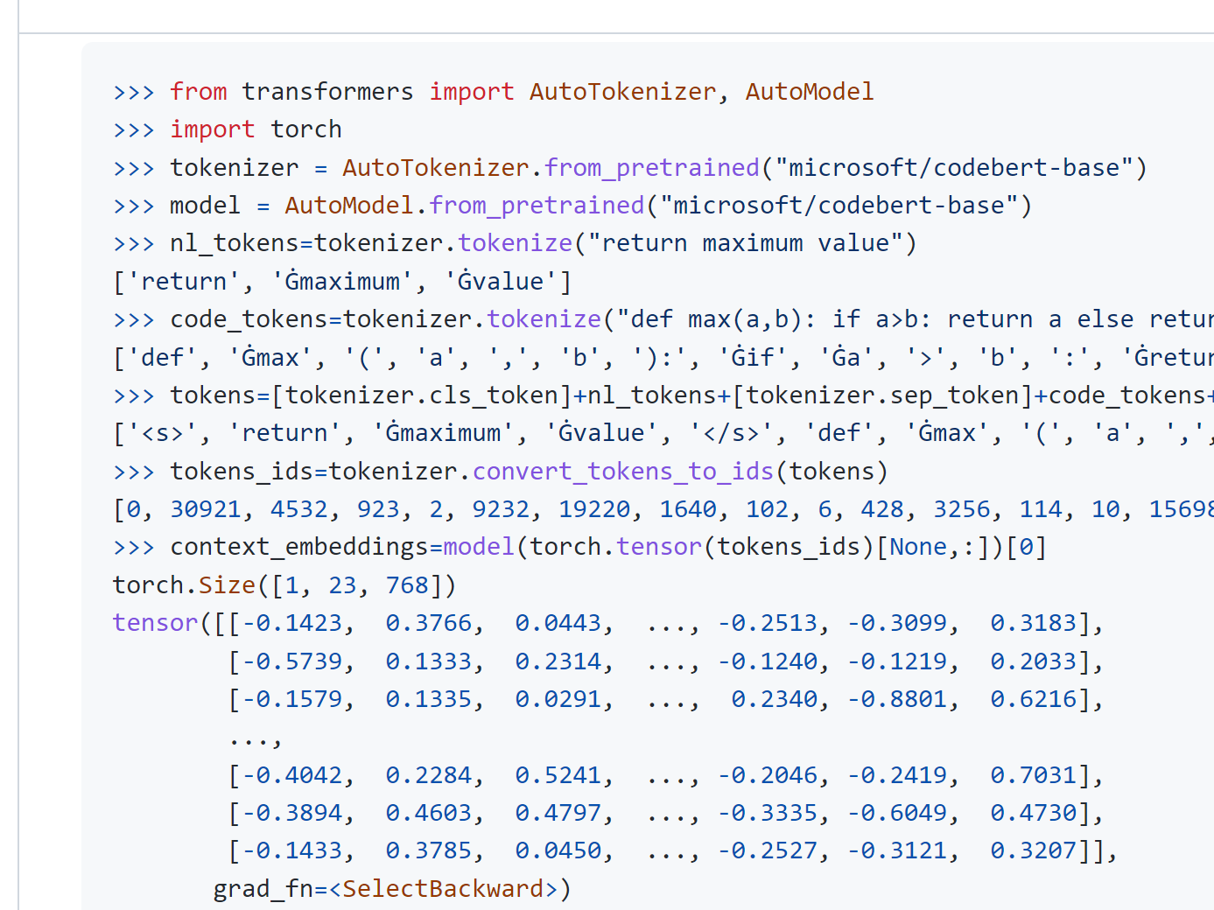
https://github.com/microsoft/CodeBERT

Slide 46
Applications
Leveraging source code
Code recommendation
Clone detection
Code completion
…

Slide 47
Code clone
Code clone refers to the code fragments with similar/same semantics (function)
E.g., If a bug is identified in one segment of code, all the similar segments need to be checked for the same bug.

Slide 48
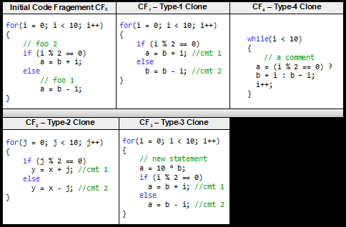
Clone types
Type-1: code fragments that are accurate copies of each other, excluding whitespaces, blank lines, and comments.
Type-2: structurally identical code fragments that may differ in the names of variables, literals and functions.
Type-3: syntactically similar code fragments that, may include changes like added or removed statements.
Type-4: clones are code fragments with a different syntax, but similar semantics.

Slide 49
Vectorization and similarity calculation
Use CodeBERT
Code snippet 1
Vector space mode (VSM)
Code snippet 2
Use CodeBERT
Notes:
How we calculate the similarity? I used vector space model here. Vsm converts each doc to a vector, the each element of a vector is tf-idf value for each word.
tf-idf is term frequency inverse document frequency.
Basically if a word appears more frequently in a doc, and less frequently in the corpus, this word is more important for the document, and higher tf-idf value it has.
Then, we use cosine similarity to compute the similarity of two vectors. Higher value indicates the enriched text is more relevant to the query.
We select top apis as the relevant ones and use them to extend our original query.

Slide 50
Applications
Leveraging source code
Code recommendation
Code clone
Code completion
…

Slide 51
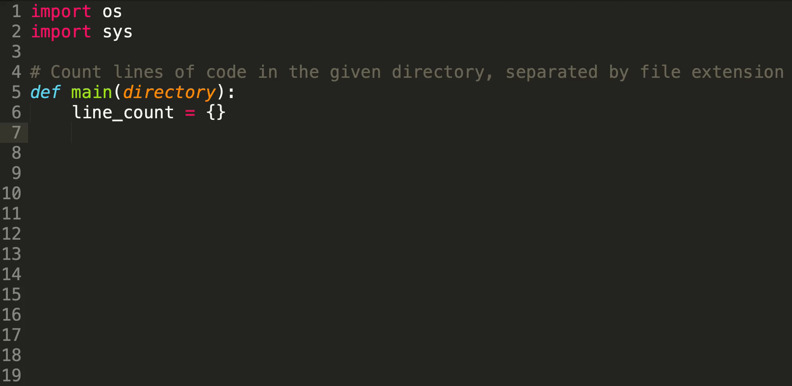
Code completion
https://www.tabnine.com/

Slide 52
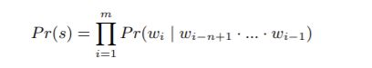
Statistic language model
N-gram language models
Determine the ith word based on previous n words.
Code completion with statistical language models. Raychev V, Vechev M, Yahav E. In Proceedings of the 35th ACM SIGPLAN Conference on Programming Language Design and Implementation 2014.

Slide 53










Statistic language model
N-gram language models

Slide 54
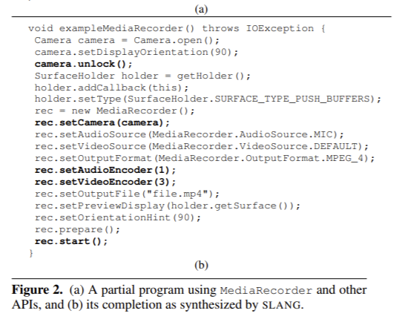














Statistic language model

Slide 55
Limitation of traditional language models
Performance improves with keeping around higher n-grams counts (e.g., 4,5,6,7) and doing smoothing.
There are a lot of n-grams
“using one machine with 140GB Ram for 2.5 days we built an unpruned model on 126 billion tokens”

Slide 56
Deep learning models
Transformer-based language model
The model is trained with a simple objective: predict the next word, given all of the previous words within some text.
GPT; GPT2; Xcode
Code and paper (https://openai.com/blog/better-language-models/)

Slide 57

Self-attention – capture the relationship of different words
https://jalammar.github.io/illustrated-transformer/

Slide 58
References & Acknowledgements
Many slides and images of this course are taken or adapted from:
Dr. David Lo and Dr. Lingxiao Jiang’s Software Mining Course
Dr. Jiawei Han’s Pattern Discovery in Data Mining Course
Dr. Emily Fox and Carlos Guestrin’s Clustering and Retrieval Course
The research papers mentioned in the slides.

Slide 59
Artifact: Issue Reports
People report bugs and feature requests that they encounter in the field
Information inside issue reports:
Description of the issue
Steps to reproduce the issue
Severity level (priority?)
Parts of the system affected by the issue
Failure traces

Slide 60
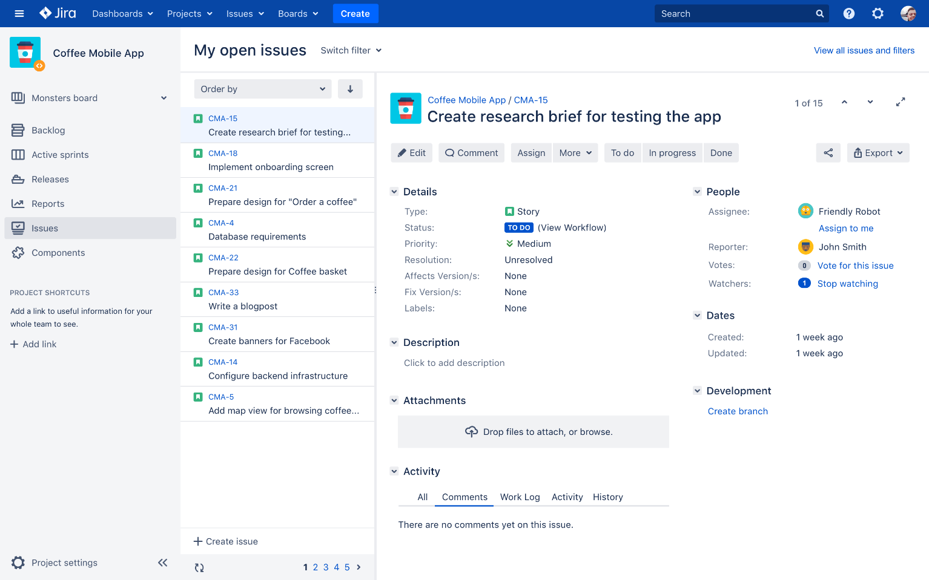
Artifact: Issue Reports
Various kinds of issue repositories
GitHub
Jira
Bugzilla
Etc.

Slide 61
Applications
Bug localization

Slide 62

Bug localization: Introduction
Program is often large with thousands of files.
Given a bug report, how to locate files responsible for the bug?
A (semi) automated solution is needed.

Slide 63
Bug Localization: Technique
Model the similarity of bug reports and files/methods
Model the bug proneness of files
Number of bugs in a file (based on its history)
Model the similarity of previous bug reports

Slide 64
Model the similarity of bug reports and files
Information retrieval techniques to calculate the similarity between reports and files
Vector space model – tfidf weighting

Slide 65
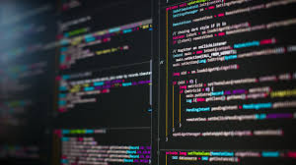
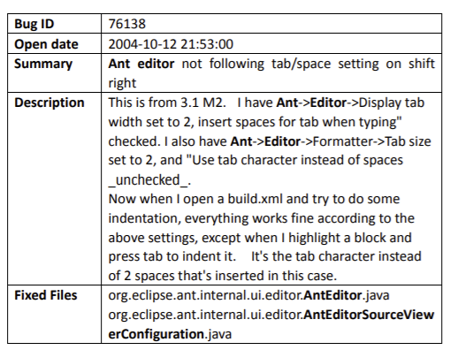
Pre-processing code
Text pre-processing
Vector_f1 [0.2,0.4, 0.6,…]
Vector_f2 [0.2,0.4, 0.6,…]
Vector_q [1,0.4, 0.2,…]
Vector_f2 [0.2,0.4, 0.6,…]

Slide 66
Pre-processing code
Text pre-processing
similarity
Vector_f1 [0.2,0.4, 0.6,…]
Vector_f2 [0.2,0.4, 0.6,…]
Vector_q [1,0.4, 0.2,…]
Vector_f2 [0.2,0.4, 0.6,…]

Slide 67

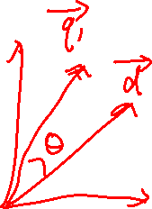
VSM: Retrieval
Represent documents and queries as vectors
Compute the similarity between the vectors
Cosine similarity is normally used:
Return top-k most similar documents
qi is the tf-idf weight of term i in the query
di is the tf-idf weight of term i in the document

Slide 68
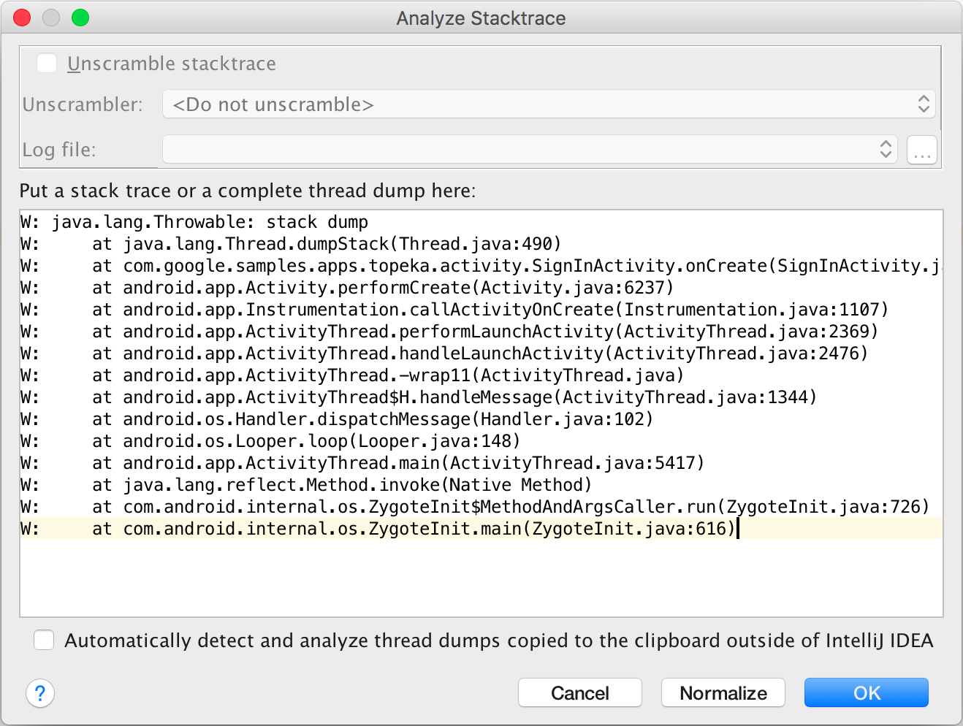
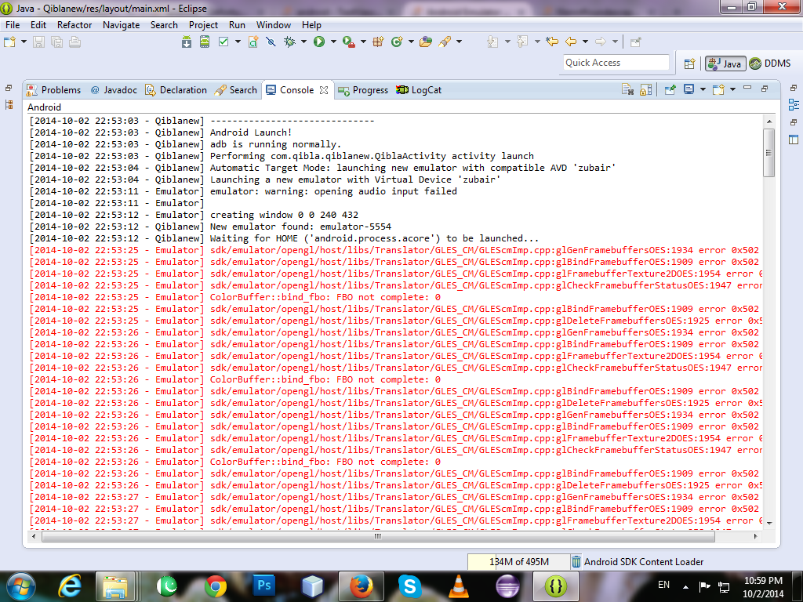
Weighting on different components
Stack trace
log

Slide 69
Model the similarity of bug reports and files
Information retrieval techniques to calculate the similarity between reports and files
Vector space model – tfidf weighting
Word2vector
Doc2vector

Slide 70
Bug Localization: Technique
Model the similarity of bug reports and files/methods
Model the bug proneness of files
Number of bugs in a file (based on its history)
Model the similarity of previous bug reports

Slide 71
Model the bug proneness of files
Observation: a file that occurs a bug recently is more likely to happen bugs again.
Similar bugs usually happen in burst and not in isolation.
Predicting Faults from Cached History, by Kim et al.

Slide 72
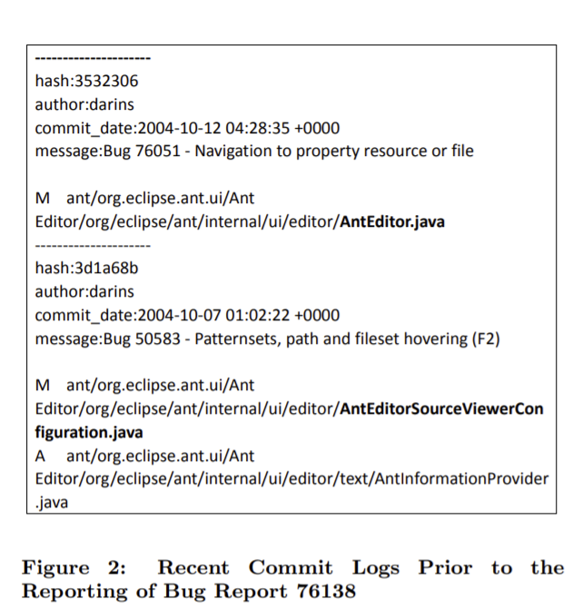
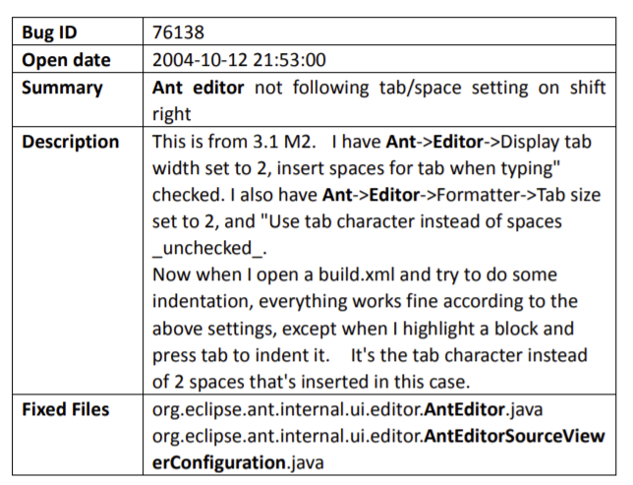




Slide 73
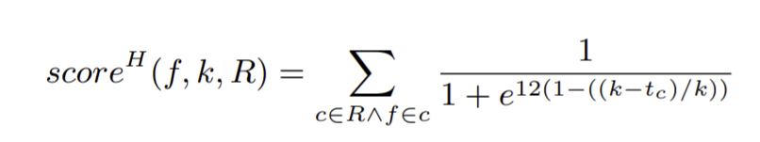


Capture frequency and time of a file being committed
Time window
Target file
number of days that has elapsed between a commit c and the input bug report.
Commits in k days

Slide 74
Bug Localization: Technique
Model the similarity of bug reports and files/methods
Model the bug proneness of files
Number of bugs in a file (based on its history)
Model the similarity of previous bug reports

Slide 75
Model the similarity of previous bug reports
Observation: similar bugs are likely to happen in similar files

Slide 76
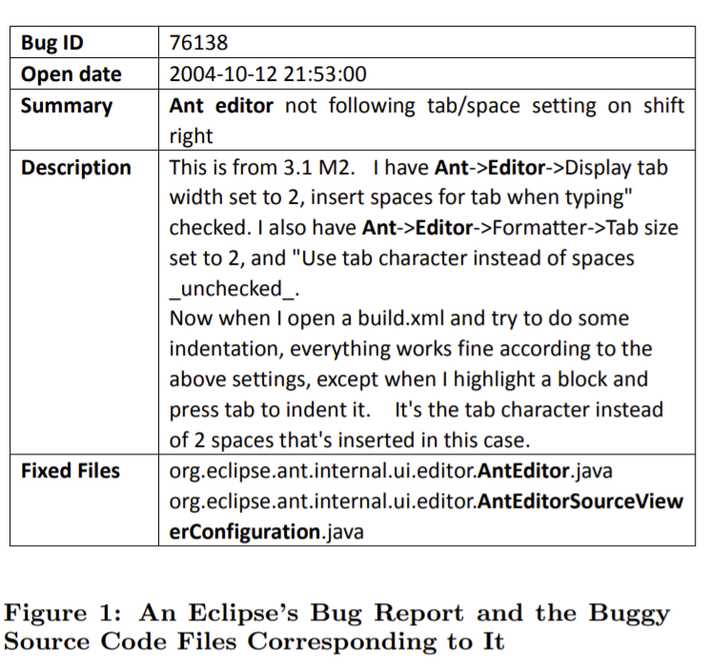
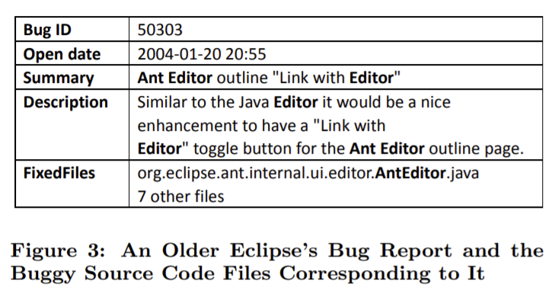

Slide 77
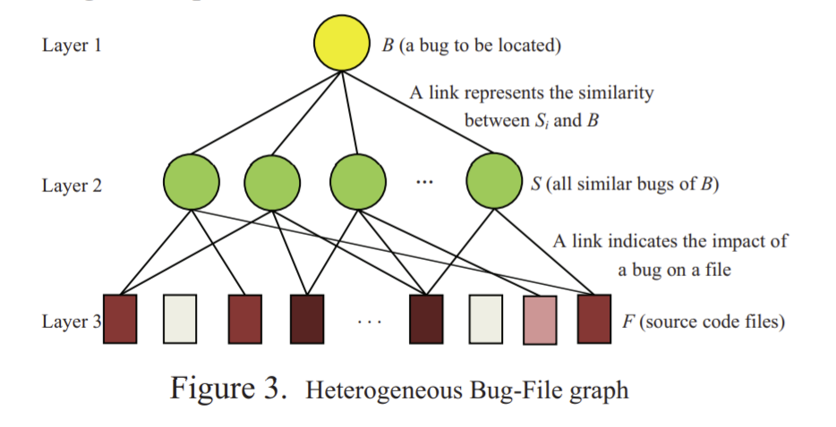
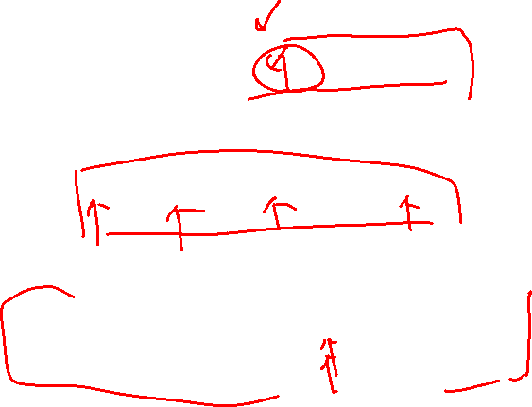
Model the similarity of previous bug reports

Slide 78
Outline
Bug localization
Prediction related studies for software bugs
Recommend developer to fix issues
Predict the severity of bugs
Etc.

Slide 79
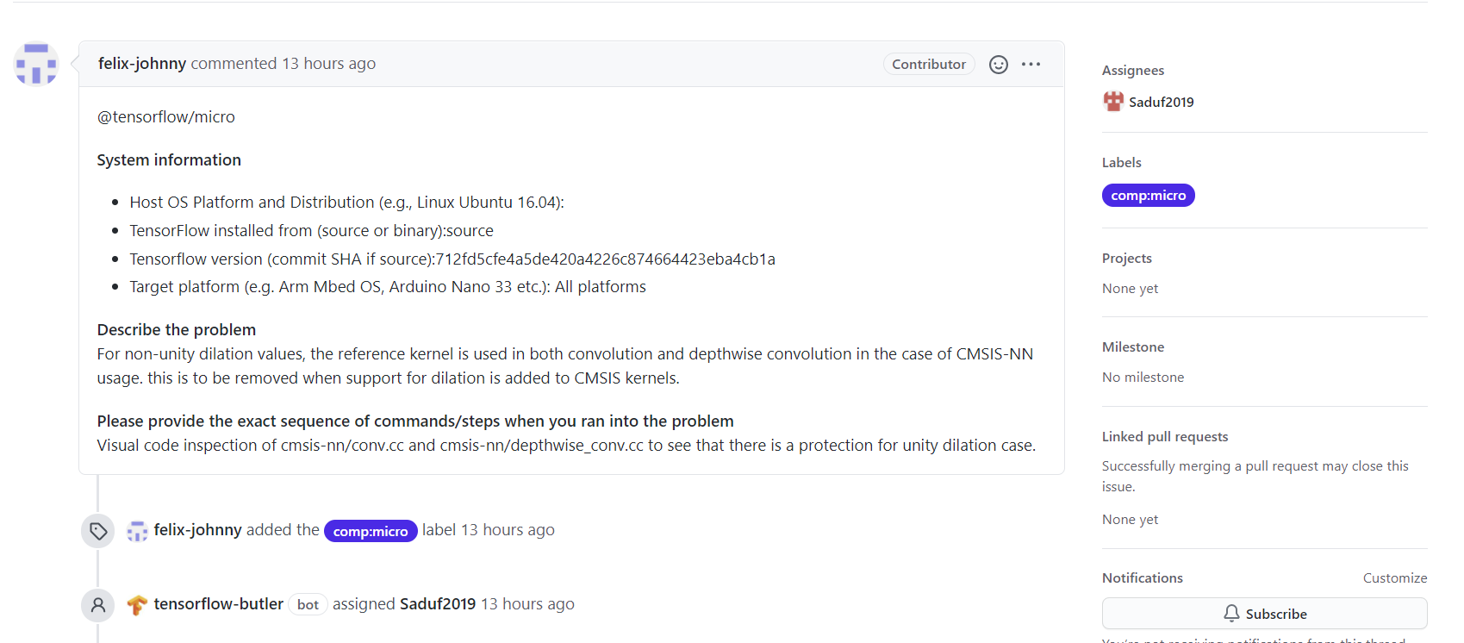



Recommend developer to fix issues: Introduction

Slide 80
Recommend developer to fix issues: Technique
Leverage activities profile
Review, commit, ownership, resolve in the bug track system
Leverage expertise
Topic model

Slide 81
Find similar issues reports
Fixer of the similar issues
Reviewer of the similar issues

Slide 82
Recommend developer to fix bugs: Technique
Leverage activities profile
Review, commit, ownership, resolve in the bug track system
Leverage expertise
Topic model

Slide 83
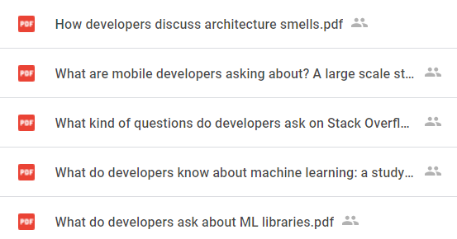
Topic Modeling
Model a group of words as a topic.
Mostly used to explore large scale of text.
Sample papers:

Slide 84
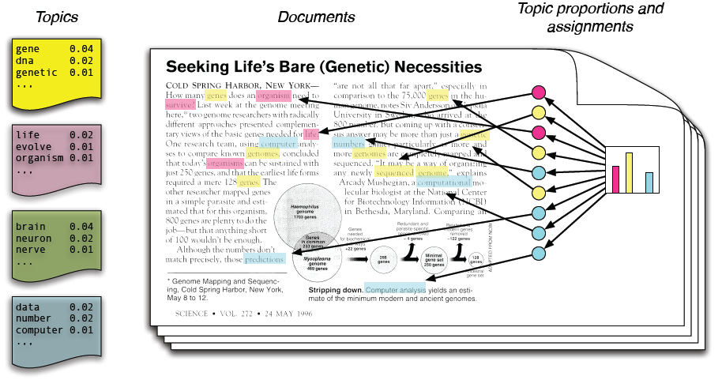
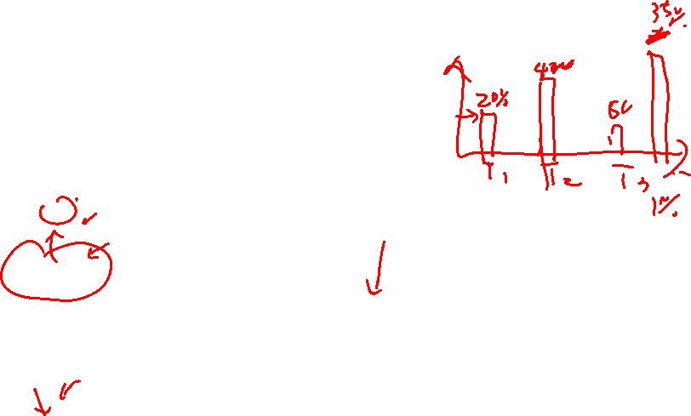
Topic Modeling: Black-Box View
Model a document as a probability distribution of topics
A topic is a probability distribution of words
Most simple and common :LDA
Notes:
Dimensionality reduction: words -> topics
Benefit: Able to link a document and a query
Do not have share any words
Share related words of the same topics

Slide 85
Usage of Topic Modeling
Dimensionality reduction: words -> topics
Help with data exploration.
Able to link a document and a query
Do not have share any words
Share related words of the same topics

Slide 86
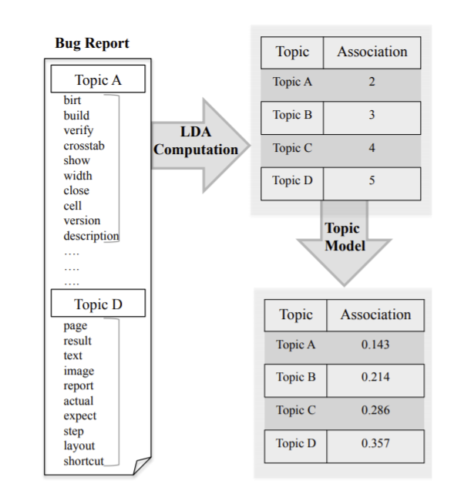

comments
Fixed bugs
Developer
Tags
Developed project/component/files

Slide 87
Leverage expertise
Model expertise of developers using topic model
VD_comment[t1,t2,… tk], VD_development[t1,t2,… tk]
Model the required expertise of a bug report using topic model
VB[t1,t2,… tk]
Match developers and bug reports based on their expertise
Calculate similarity

